Slide 1
Document Classification with Transformer Models
By Gopalakrishnan Kumar, MTech IIT-Bombay,
Freelance Data Science Consultant
LinkedIn: Profile Link : https://www.linkedin.com/in/gopalakrishnankumar-a73301110/
Github:https://www.github.com/Gopalakrishnan-Kumar/
Kaggle URL- https://www.kaggle.com/gopalkk2

Slide 2
Google Colab URL
https://colab.research.google.com/drive/1HjJ1jzyYo8AZtZDl1gz8VNQ744fxHtO-?usp=sharing

Slide 3
Project Overview
This project applies BERT (Bidirectional Encoder Representations from Transformers) to classify text documents into predefined categories. It demonstrates how to fine-tune a pre-trained BERT model on a custom CSV dataset using the Hugging Face Transformers library, and evaluates the model using accuracy, F1 score, and confusion matrix.

Slide 4
Dataset Description
Input Format: CSV file with two columns:
text: The document content.
label: The class/category of the document.
Example Labels: business, sports, science, politics, etc.
Dataset is split into training and testing sets using an 80/20 split.

Slide 5
Methodology
Data Preprocessing
Model Architecture
Labels are encoded using LabelEncoder.
Text is tokenized using BertTokenizer with padding and truncation.
Converted into Hugging Face Dataset format for efficient batching.
Pre-trained bert-base-uncased is used.
A classification head is added to output probabilities over classes.
Loss Function: Cross-Entropy for multi-class classification.

Slide 6
Methodology
Training
Batch size: 8
Epochs: 3
Learning rate: 2e-5
Optimizer: AdamW
Evaluation is performed after each epoch.

Slide 7
Evaluation Metrics
Accuracy: Measures overall correctness.
F1 Score (Weighted): Accounts for label imbalance.
Confusion Matrix: Visualizes misclassifications.

Slide 8
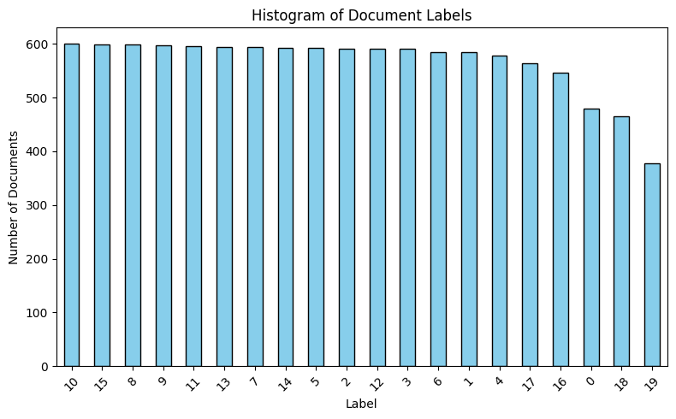
Data Visualization
Histogram: Displays document labels

Slide 9
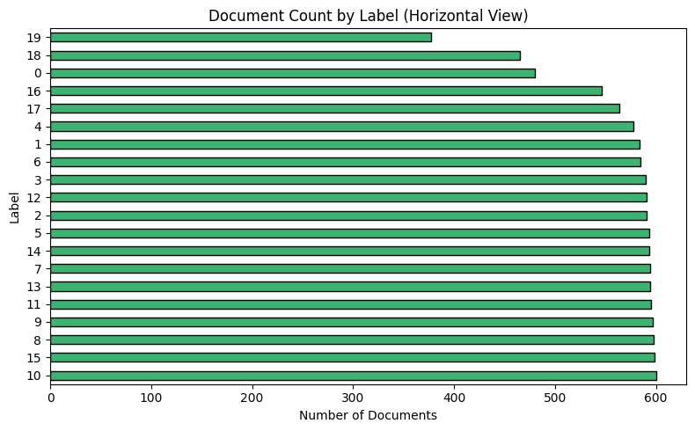
Data Visualization
Histogram: Displays document labels

Slide 10
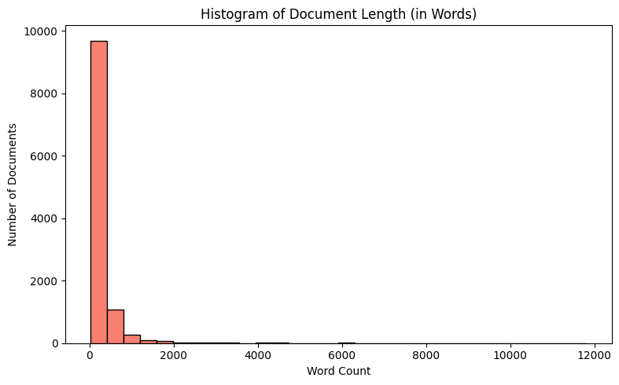
Data Visualization
Histogram: Displays document length in words

Slide 11
Results
Metric | Value
Accuracy | ~0.85
F1-Score | ~0.84 (weighted)
Best Accuracy Observed | After Epoch 3
The model performed well across most categories.
Minor misclassification occurred between semantically close categories
(e.g., politics vs world).

Slide 12
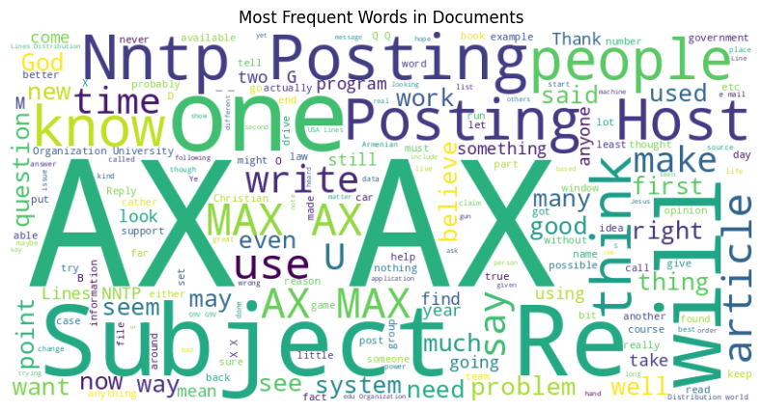
Data Visualization

Slide 13
Insights
BERT effectively captures contextual relationships in text, making it a strong baseline for document classification tasks.
Label imbalance (if any) can affect performance — consider class weights or sampling.
Further tuning with more data or longer training can improve results.

Slide 14
Future Work
Try DistilBERT for faster and lighter training.
Extend to multi-label classification (documents with multiple tags).
Integrate with a web app (Streamlit or Gradio) for live document classification.
Use attention visualization for explainability.

Slide 15
Conclusion
This project successfully demonstrates how to fine-tune a pre-trained BERT model on a labeled dataset for document classification. The approach is scalable, reproducible, and adaptable to many NLP classification tasks such as news tagging, topic modeling, or content moderation.

